Slide 1
ITIS 6120 Applied Database – Project 3
Voter Data Visualization
Team Members:
Ramesh Chelliah
Divya Lakshmi Rani Kuppusamy
Tamil Selvan Valathy Shanmugam

Slide 2
Overview
Introduction
Schemas
Use Cases
Database Oriented techniques applied
Conclusion

Slide 3
Introduction
This project is targeted towards developing
a convenient and better way of visualizing
the statistics of election taking place using Tableau and predicting the winner of the election based on the past voting data

Slide 4
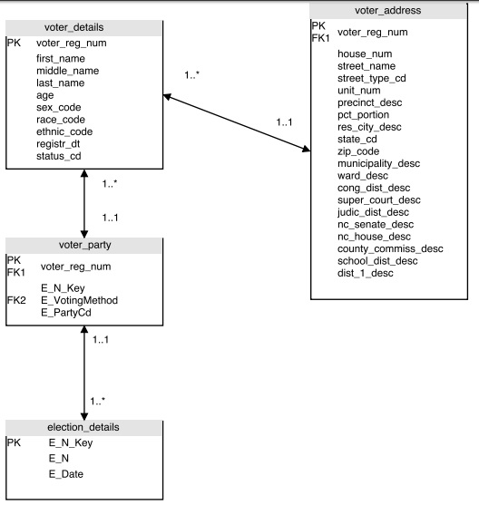
Schema

Slide 5
Tables:
voter_details
voter_party
election_details
voter_address
Views:
Votes_Per_Party
Votes_Per_City
Votes_Per_Age
Votes_Per_VotingMethod

Slide 6
Use Cases
The city that has contributed the maximum number of votes
The age group that has contributed for the maximum number of votes and the number of un-casted votes
The voting method that is used the most in the election process

Slide 7
Use Cases
Party Wise Number of votes in a particular city for a particular year
Mean of the number of votes for the different parties over the years
Finding the number of voters who are consistent enough in casting their votes for the same party.
Finding the number of elections the people have appeared in all the years.

Slide 8
Database Oriented Techniques Applied
Stored Procedures
For Insertion and Update Anomalies
Views
For vote count, prediction and Survey results
Administrative Commands
For administrative functionalities

Slide 9
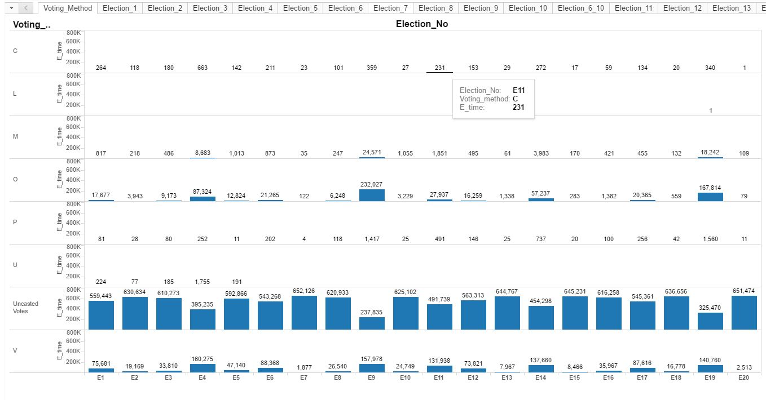
Use Case

Slide 10
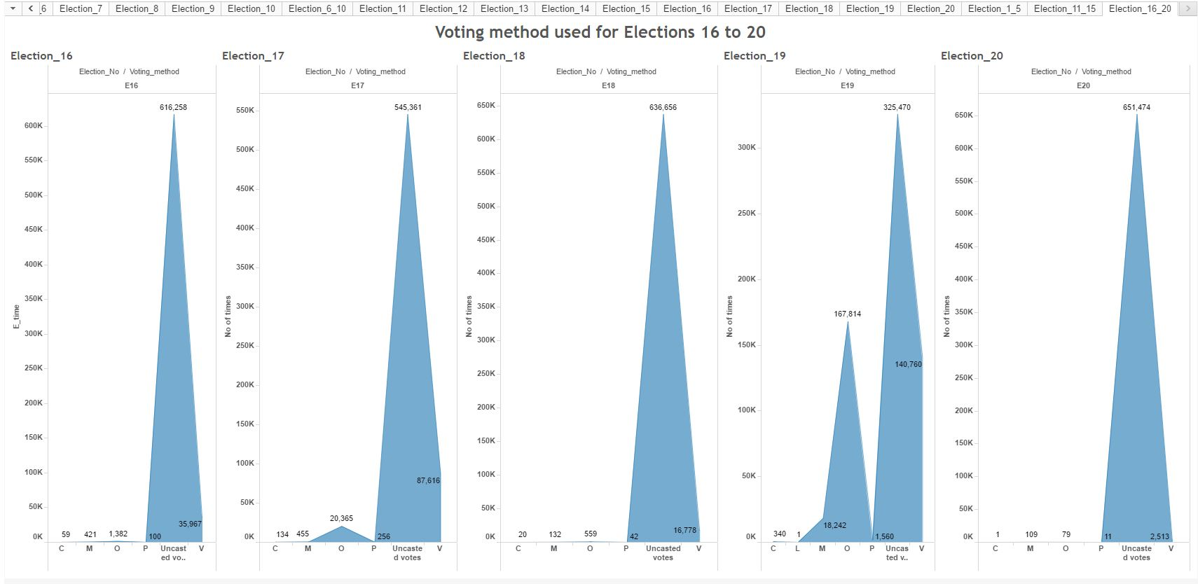
Use Case

Slide 11
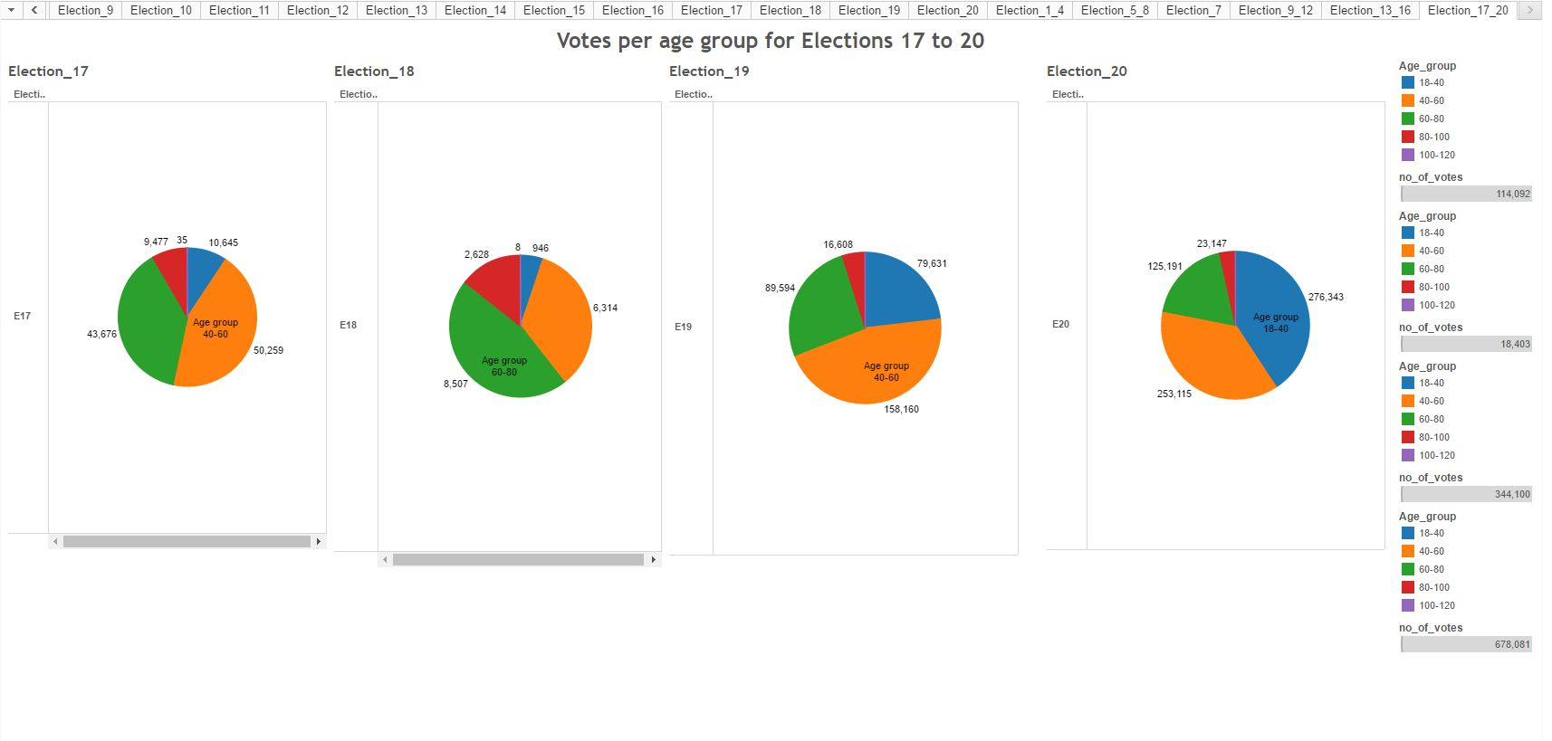
Use Case

Slide 12
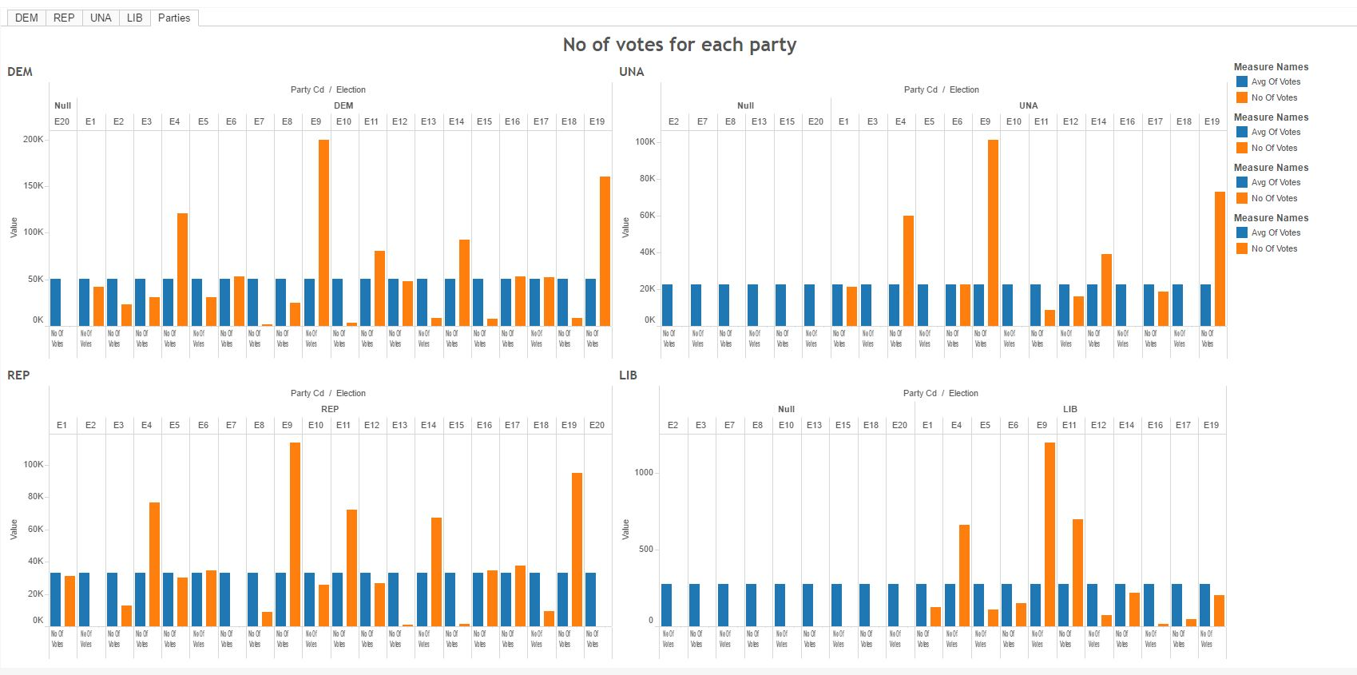
Use Case

Slide 13
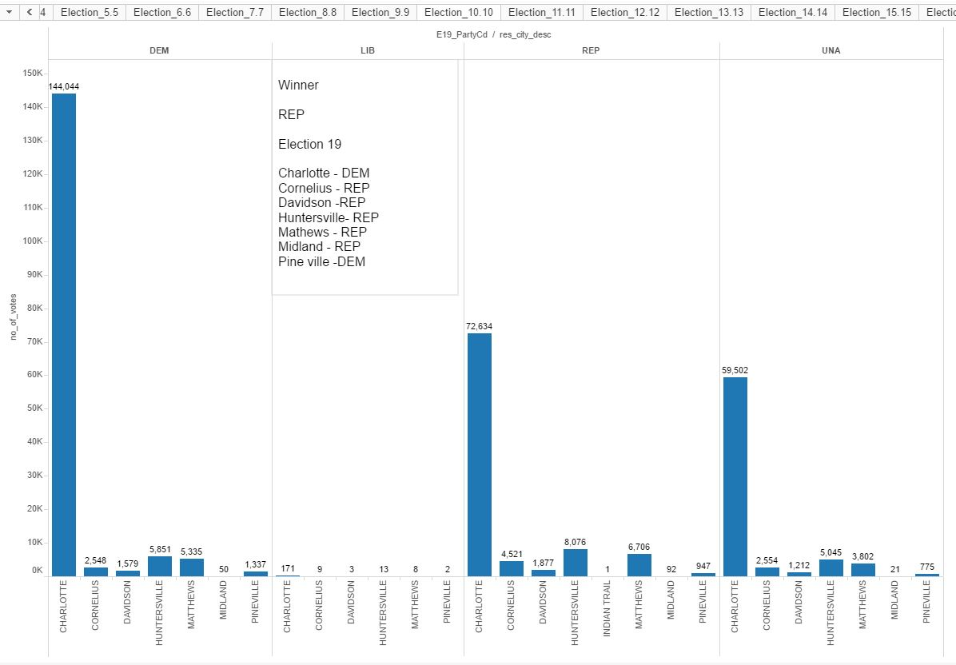
Use Case

Slide 14
Challenges Faced
Query Execution Delay while running through tableau for custom query
Loading the substantial data set into normalized tables

Slide 15
Conclusion
Voting data analysis has been visualized and reported in the form of pie and bar charts
Mecklenburg county election voter Data Set has been used
The Front End GUI has been built on Tableau tool
MySQL Workbench 6.3 is used for working with the database

